Slide 1
Face Mask Detection
NAME: Sanket Subhash Raut
ROLL NO:2021510054
Class: FYMCA

Slide 2
_{INTRODUTION}
The COVID19 virus can be spread through contact and contaminated surfaces. There are so many essential equipments needed to fight against the Corona virus. One of such most essential is Face Mask.
Firstly, a face mask was not mandatory for everyone but as the day progresses scientists and Doctors have recommended everyone to wear a face mask.
So to detect whether a person is wearing Face Mask or not is an essential process to implement in the society currently which can be used for various applications like at the airport, hospitals, offices, schools, etc.

Slide 3
This system can be of great importance at airports to detect travelers whether they are wearing a mask or not and at schools to ensure students are wearing a face mask for their safety.
Face mask detection refers to detect whether a person is wearing a mask or not. In fact, the problem is reverse engineering of face detection where the face is detected using different machine learning algorithms for the purpose of security, authentication and surveillance.

Slide 4
PROPOED METHOD
This Mask detector utilizes a Caffe-based face detector in conjunction with a fine-tuned MobileNetV2 for mask-wearing classification. we able to achieve a decent 0.93 f1-score on the classifier. This face mask detector doesn't use any morphed masked images dataset and the model is accurate.
Owing to the use of MobileNetV2 architecture, it is computationally efficient, thus making it easier to deploy the model to embedded systems (Raspberry Pi, Google Coral, etc.).
This system can therefore be used in real-time applications which require face-mask detection for safety purposes due to the outbreak of Covid-19.

Slide 5
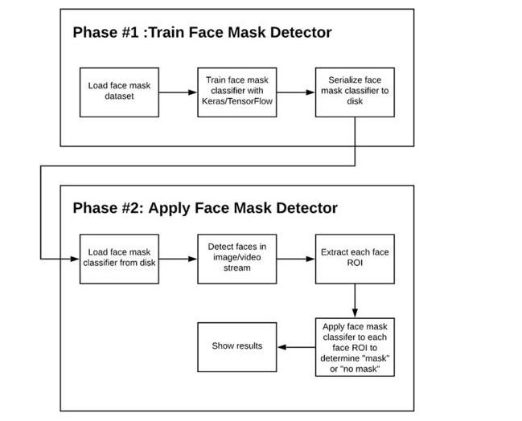
Block Diagram of
Two-phase COVID-19 face mask detector

Slide 6
Main Libraries Used in Project
Pandas
Numpy
Sklearn
Tensorflow
Keras
Matplotlib
Mobilenet2

Slide 7
System Requirements
Hardware requirements :
Windows/Linux/Mac OS Machine
RAM 4GB or more
System type: 64-bit OS
x64-based processor
Software Requirements:
Python 3
Any Python IDE
Streamlit Library

Slide 8
PROBLEM FACED
While building this model the problem faced was that the Deep Learning Algorithms CNN requires a lot of training data.
The other problem is that since the features are extracted it takes too much time to extract the features because the model is learning form it and also requires memory for calculating the features.
The requirement of GPU can be a problem to process the dataset as it required an efficient GPU for system training.
Model takes so much time to train.

Slide 9
Conclusion
Deep learning-based method and quantization-based technique achieves a high recognition performance
For the best of our knowledge, this work addresses the problem of masked face recognition and different approaches during COVID19 pandemic.
It is worth stating that this study is not limited to this pandemic period since a lot of people are self-aware constantly, they take care of their health and wear masks to protect themselves against pollution and to reduce other pathogens transmission.

Slide 10
References and Bibliography
Gala, J. L. (2020). Frequently asked questions « masque citoyen » « protection mutuelle ». https://cdn.nimbu.io/s/ gd6c0r0/assets/1588090828970/FAQ-Masque-2020-04-28.pdf.
Leung, N., Chu, D., Shiu, E., Chan, K., McDevitt, J. et al. (2020). Respiratory virus shedding in exhaled breath and efficacy of face masks. Nature Medicine, 26(5), 676–680. DOI 10.1038/s41591-020-0843-2
https://www.pyimagesearch.com/
https://www.tensorflow.org/tutorials/images/transfer_learning

Slide 11
Thank You ☺

